Slide 1
Dispersion in Optical Fibre (I)
A.SANGEETHA

Slide 2
Introduction
Dispersion limits available bandwidth
As bit rates are increasing, dispersion is becoming a critical aspect of most systems
Dispersion can be reduced by fibre design
Optical source selection is important

Slide 3
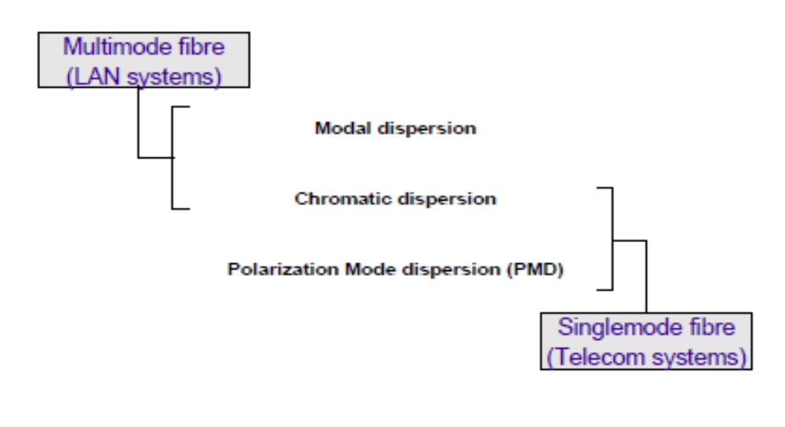
Dispersion in an Optical Fibre

Slide 4
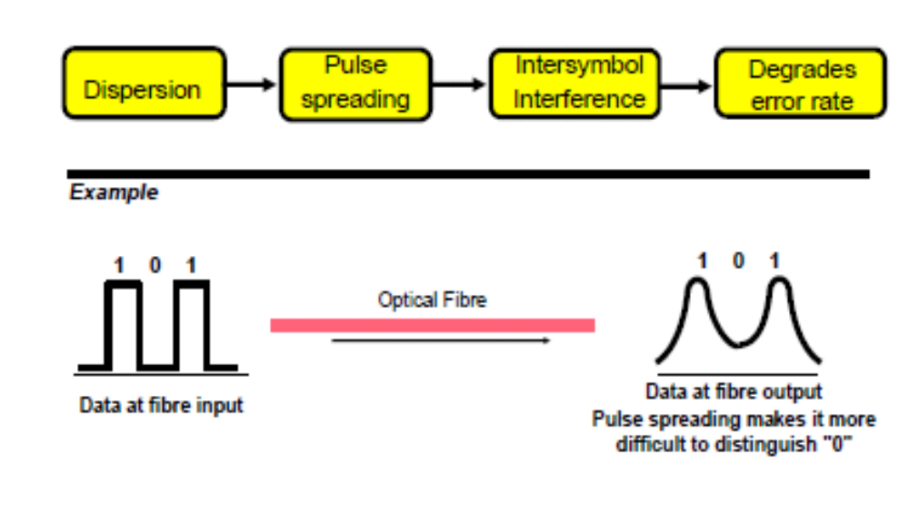
Why is dispersion a problem?

Slide 5
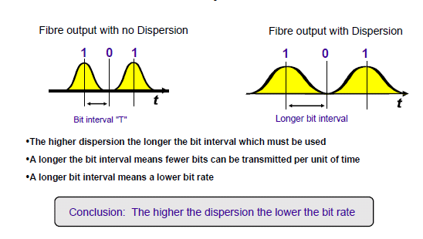
Dispersion and Bit Rate

Slide 6
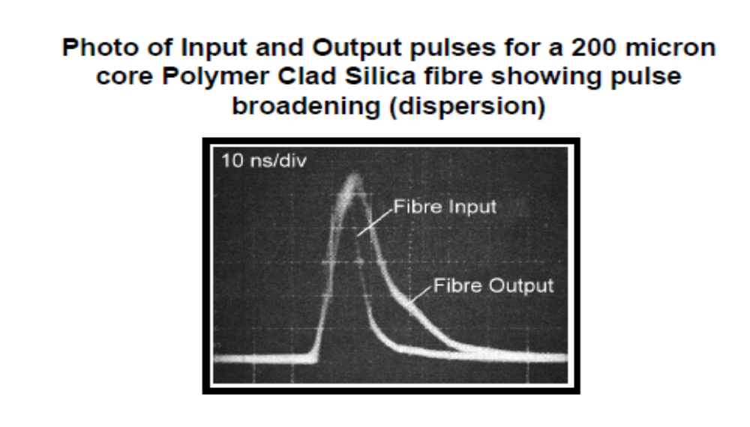
Dispersion Example

Slide 7
Dispersion in Optical Fibers
Dispersion: Any phenomenon in which the velocity of propagation of any electromagnetic wave is wavelength dependent.
In communication, dispersion is used to describe any process by which any electromagnetic signal propagating in a physical medium is degraded because the various wave characteristics (i.e., frequencies) of the signal have different propagation velocities within the physical medium.
There are 3 dispersion types in SINGLE MODE optical fibers, in general:
1- Material Dispersion
2- Waveguide Dispersion
3- Polarization-Mode Dispersion
Material & waveguide dispersions are main causes of Intramodal Dispersion.

Slide 8
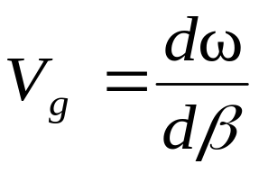
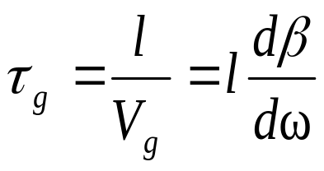
Group Velocity & Group Delay
The group velocity is given by:
The group delay is given by:
It is important to note that all above quantities depend both on frequency & the propagation mode. In order to see the effect of these parameters on group velocity and delay, the following analysis would be helpful.
[3-6]
[3-7]

Slide 9
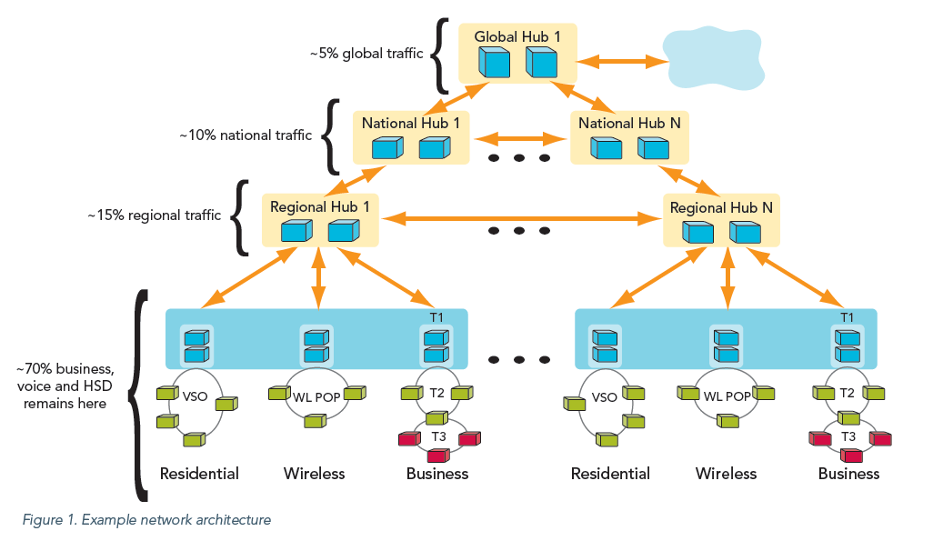

Traffic data pattern analysis shows that the primary bandwidth drivers are high-speed Internet across regional and long-haul networks, and uni-cast video traffic in metro networks.

Slide 10
cables
7m over copper, based on 10 x 10G (100GBASE-CR10)
100m on multi-mode fiber, based on 10 x 10G, with 10 fibers per direction (100GBASE-SR10)
10 km on single-mode fiber, based on 4 x 25G, 800GHz spacing DWDM (100GBASE-LR4)
40 km single-mode fiber, based on 4 x 25G 800GHz spacing DWDM (100GBASE-ER4)
The 10km and 40km single-mode fiber variants are most relevant for optical transport.

Slide 11
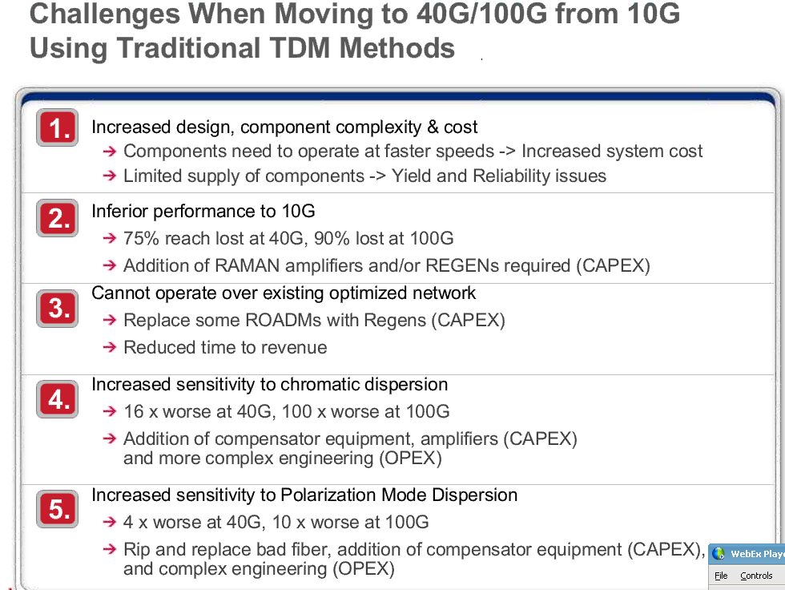

Slide 12
Intramodal dispersion or Group Velocity Dispersion (GVD). This phenomenon arises due to a finite bandwidth of the optical source, dependency of refractive index on the wavelength and the modal dependency of the group velocity.
In the case of optical pulse propagation down the fiber, GVD causes pulse broadening, leading to Inter Symbol Interference (ISI).

Slide 13
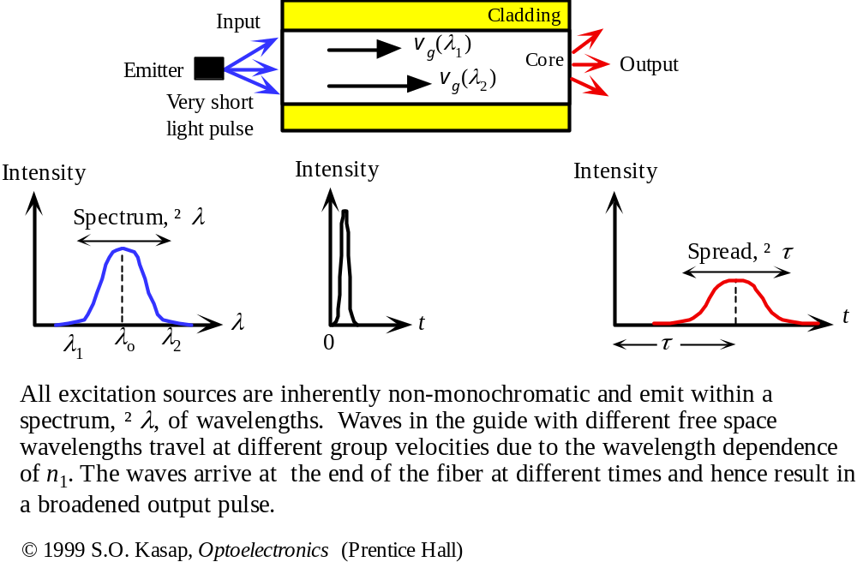
Material Dispersion

Slide 14

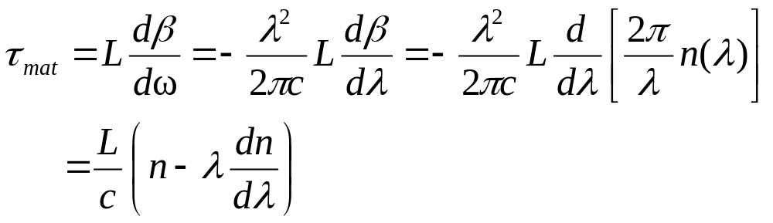
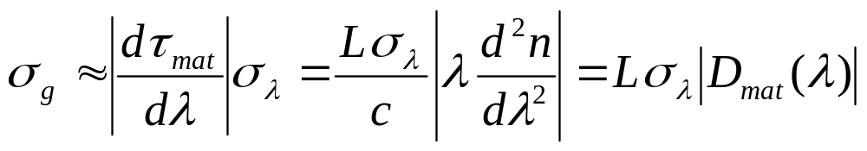

Material Dispersion
The refractive index of the material varies as a function of wavelength,
Material-induced dispersion for a plane wave propagation in homogeneous medium of refractive index n:
The pulse spread due to material dispersion is therefore:
[3-19]
[3-20]
is material dispersion

Slide 15
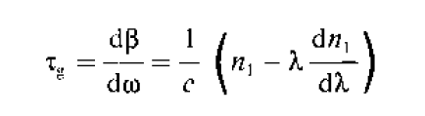

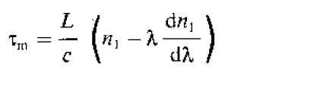

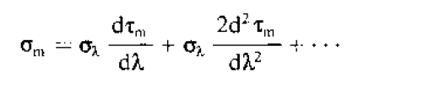

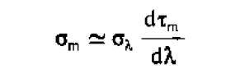



Slide 16
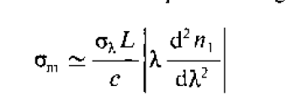

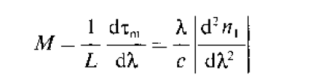

Slide 17
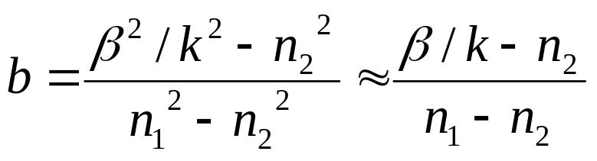
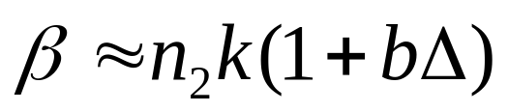

Waveguide Dispersion
Waveguide dispersion is due to the dependency of the group velocity of the fundamental mode as well as other modes on the V number. In order to calculate waveguide dispersion, we consider that n is not dependent on wavelength. Defining the normalized propagation constant b as:
solving for propagation constant:
Using V number:
[3-21]
[3-22]
[3-23]

Slide 18
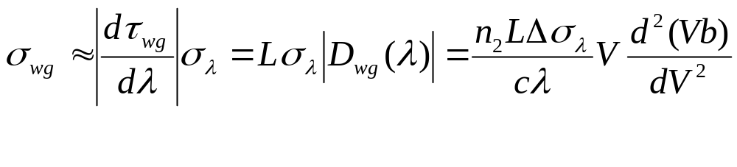
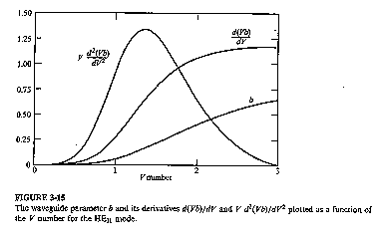

Waveguide dispersion in single mode fibers
For single mode fibers, waveguide dispersion is in the same order of material dispersion. The pulse spread can be well approximated as:
[3-25]
Optical Fiber communications, 3rd ed.,G.Keiser,McGrawHill, 2000

Slide 19
Modal Dispersion
In a multimode fibre different modes travel at different velocities
If a pulse is constituted from different modes then intermodal dispersion occurs
Modal dispersion is greatest in multimode step index fibres
The drive to reduce modal dispersion led to the development of graded index multimode fibre and singlemode fibre.
A ray model can give and adequate description of modal dispersion

Slide 20
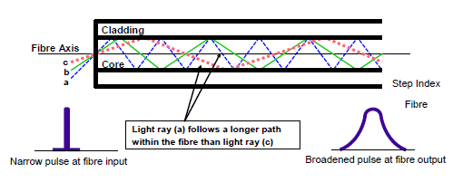
Modal Dispersion
􀁹Modal dispersion is greatest in multimode step index fibres
􀁹The more modes the greater the modal dispersion
􀁹Typical bandwidth of a step index fibre may be as low as 10 MHz over 1 km

Slide 21
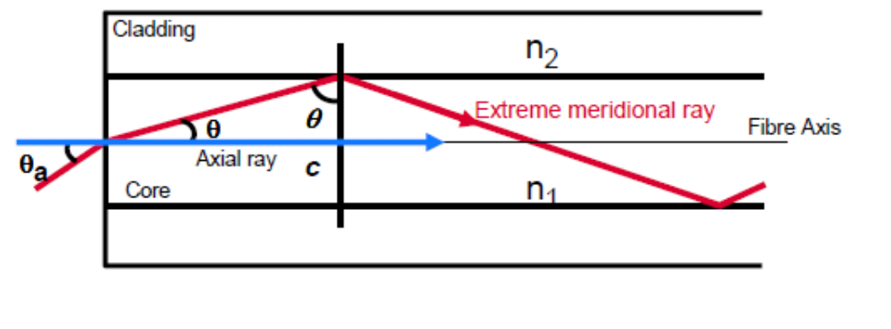
Estimating Modal Dispersion
(Step Index Fibre)
Assume:
• Step index fibre
• An impulse-like fibre input pulse
• Energy is equally distributed between rays with paths lying between the axial and
the extreme meridional
􀁹What is the difference in delay for the two extremes over a linear path length L?

Slide 22
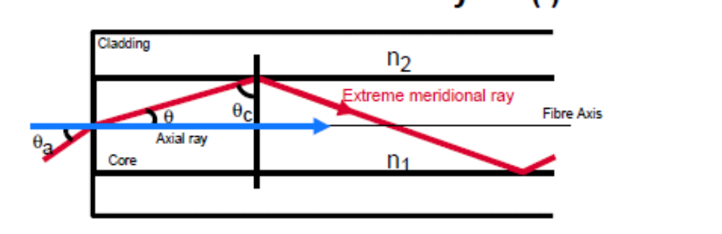
Step Index Modal Dispersion:
Analysis (I)
Transmission distance = L
Tmax = Transmission time for extreme meridional ray
Tmin = Transmission time for axial ray
Delay difference δt = Tmax - Tmin

Slide 23
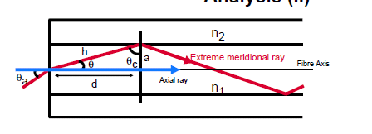
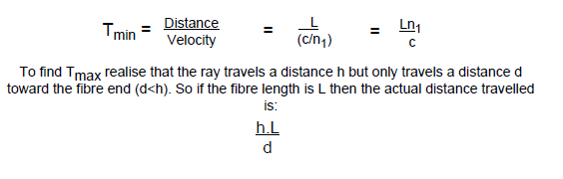
Step Index Modal Dispersion:
Analysis (II)

Slide 24
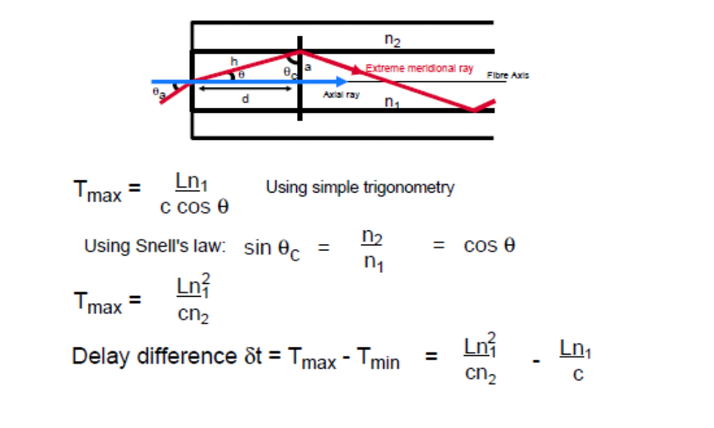
Step Index Modal Dispersion:
Analysis (III)

Slide 25
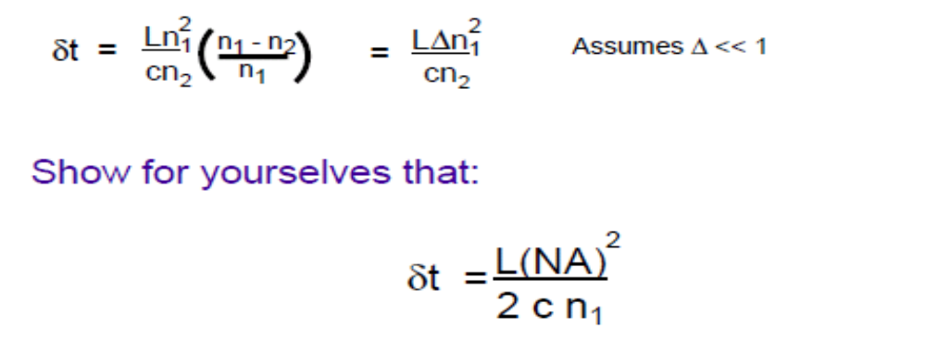
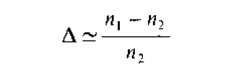

Step Index Modal Dispersion:
Analysis (IV)

Slide 26
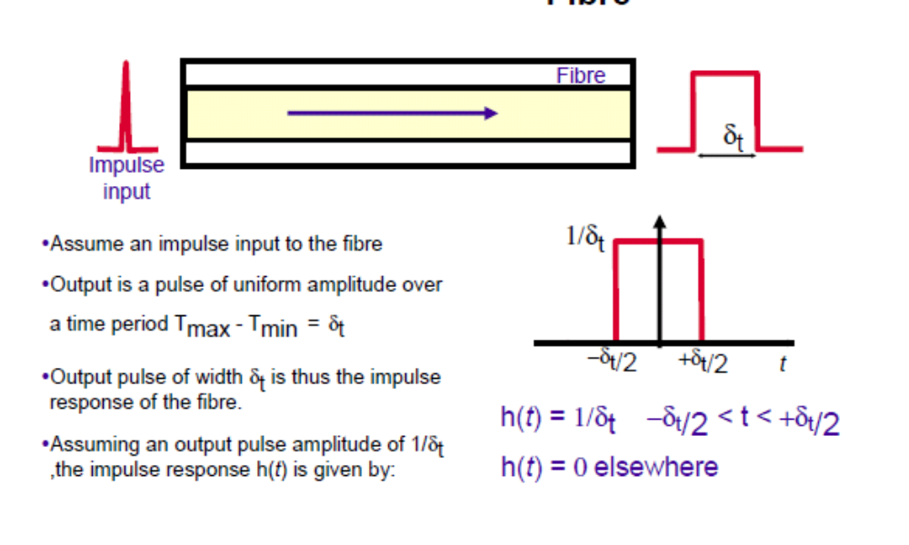
Impulse Response for Step Index
Fibre

Slide 27
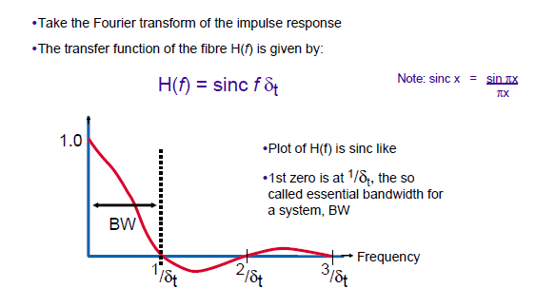
Transfer Function for a Step
Index Fibre

Slide 28
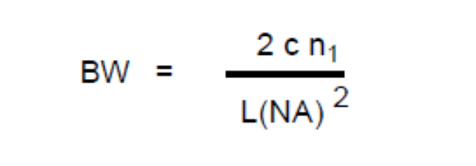
Bandwidth for a Step Index Fibre
􀁹Essential bandwidth, BW, for the fibre is 1/δt
􀁹Based on the previous analysis BW can be written as:
􀁹BW get smaller as fibre length L increases
􀁹High NA fibres have lower bandwidths, eg plastic fibre has high NA: Poor bandwidth
􀁹Lowering NA to improve bandwidth makes source coupling more difficult as the acceptance angle decreases

Slide 29
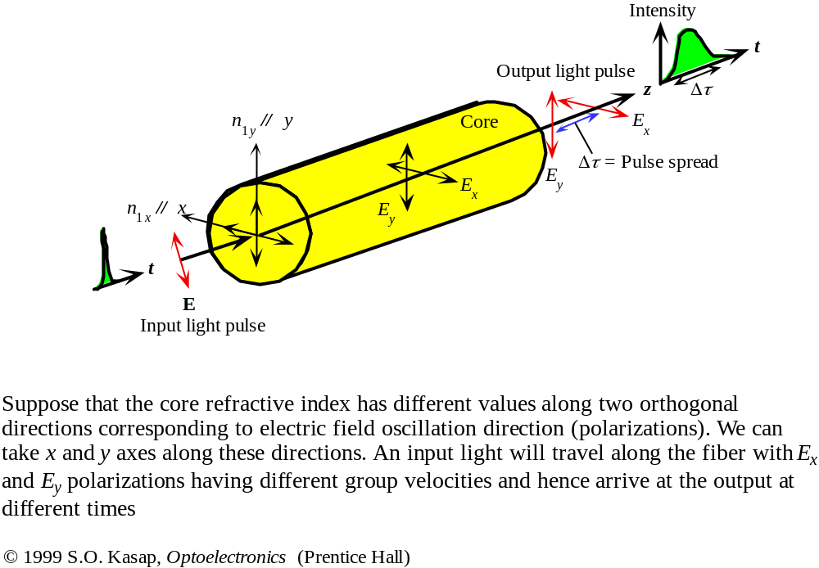
Polarization Mode dispersion

Slide 30


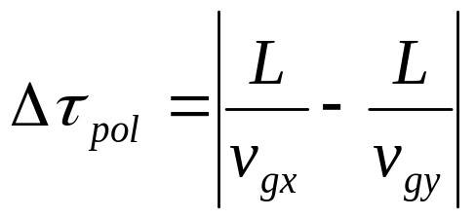
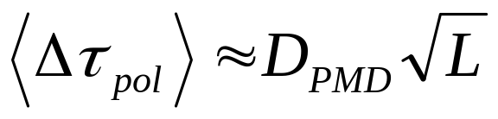
Polarization Mode dispersion
The effects of fiber-birefringence on the polarization states of an optical are another source of pulse broadening. Polarization mode dispersion (PMD) is due to slightly different velocity for each polarization mode because of the lack of perfectly symmetric & anisotropicity of the fiber. If the group velocities of two orthogonal polarization modes are then the differential time delay between these two polarization over a distance L is
The rms value of the differential group delay can be approximated as:
[3-26]
[3-27]

Slide 31
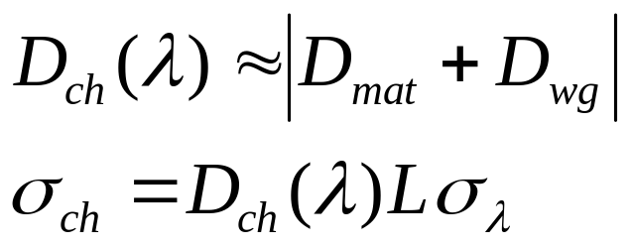
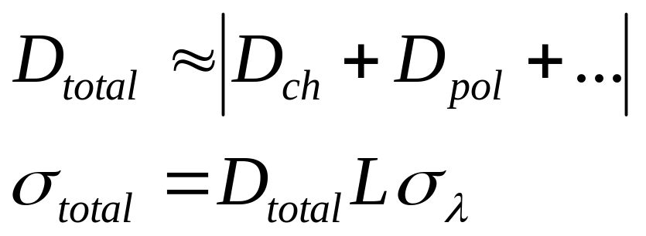
Chromatic & Total Dispersion
Chromatic dispersion includes the material & waveguide dispersions.
Total dispersion is the sum of chromatic , polarization dispersion and other dispersion types and the total rms pulse spreading can be approximately written as:
[3-28]
[3-29]

Slide 32
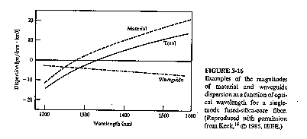
Total Dispersion, zero Dispersion
Fact 1) Minimum distortion at wavelength about 1300 nm for single mode silica fiber.
Fact 2) Minimum attenuation is at 1550 nm for sinlge mode silica fiber.
Strategy: shifting the zero-dispersion to longer wavelength for minimum attenuation and dispersion.
Optical Fiber communications, 3rd ed.,G.Keiser,McGrawHill, 2000

Slide 33

Optimum single mode fiber & distortion/attenuation characteristics
Fact 1) Minimum distortion at wavelength about 1300 nm for single mode silica fiber.
Fact 2) Minimum attenuation is at 1550 nm for single mode silica fiber.
Strategy: shifting the zero-dispersion to longer wavelength for minimum attenuation and dispersion by Modifying waveguide dispersion by changing from a simple step-index core profile to more complicated profiles. There are four major categories to do that:
1- 1300 nm optimized single mode step-fibers: matched cladding (mode diameter 9.6 micrometer) and depressed-cladding (mode diameter about 9 micrometer)
2- Dispersion shifted fibers.
3- Dispersion-flattened fibers.
4- Large-effective area (LEA) fibers (less nonlinearities for fiber optical amplifier applications, effective cross section areas are typically greater than 100 ).

Slide 34
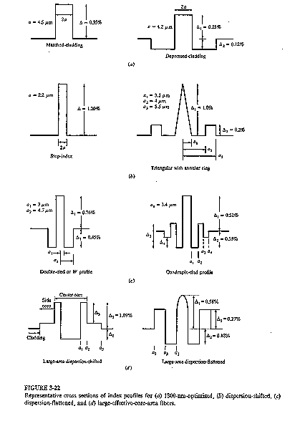

Slide 35
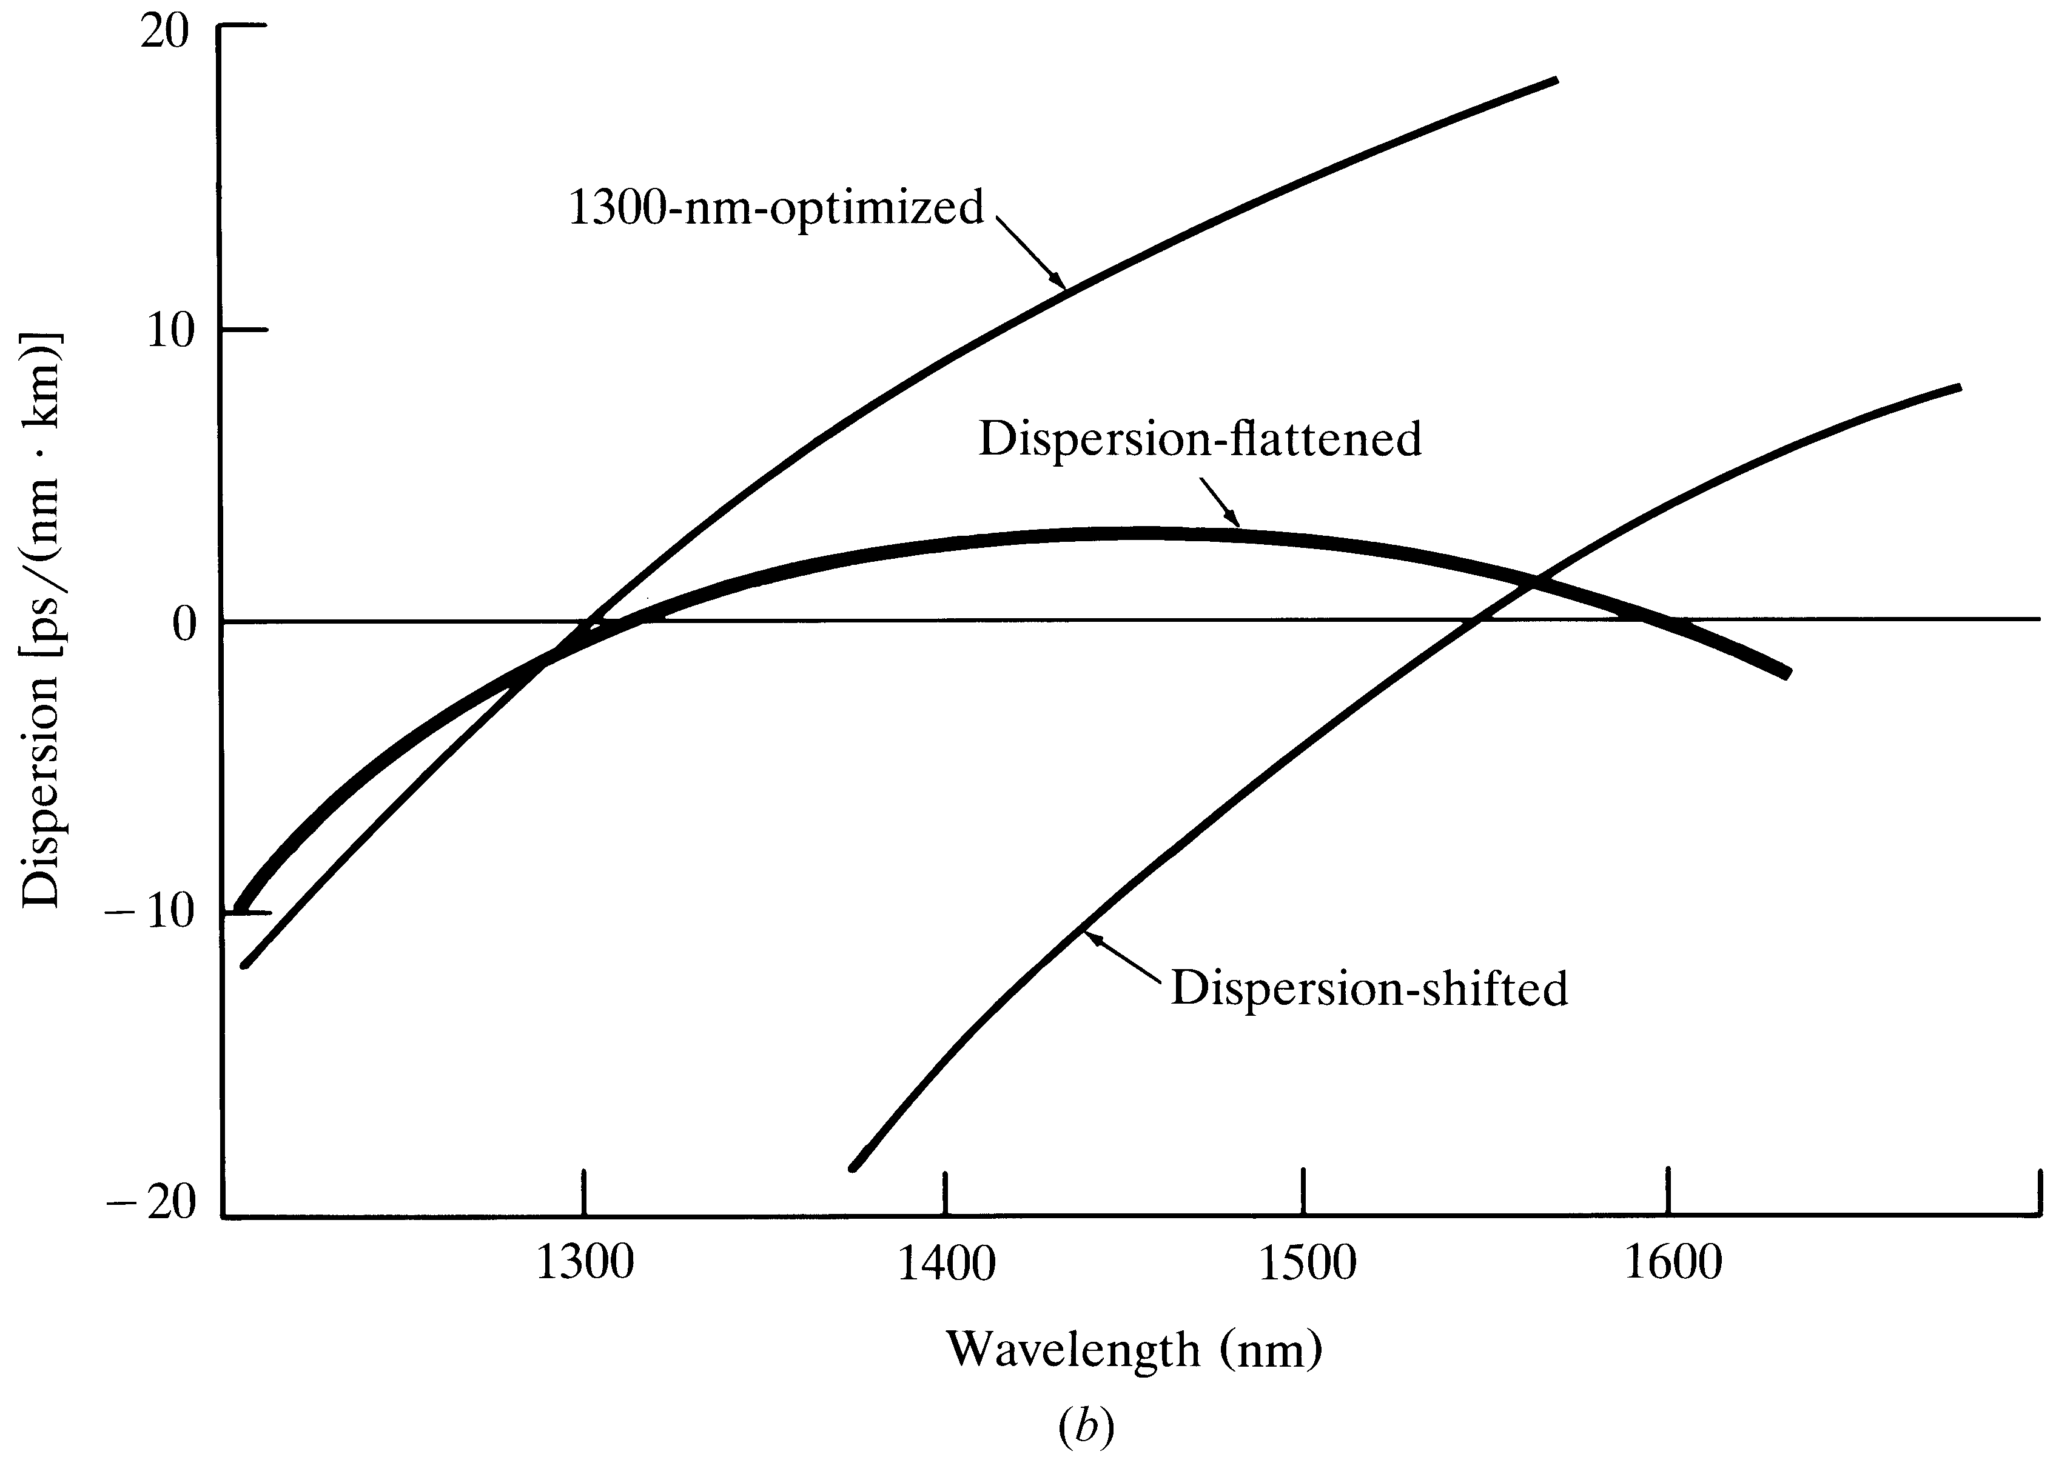
Single mode fiber dispersion
Optical Fiber communications, 3rd ed.,G.Keiser,McGrawHill, 2000

Slide 36

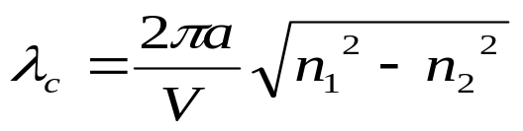
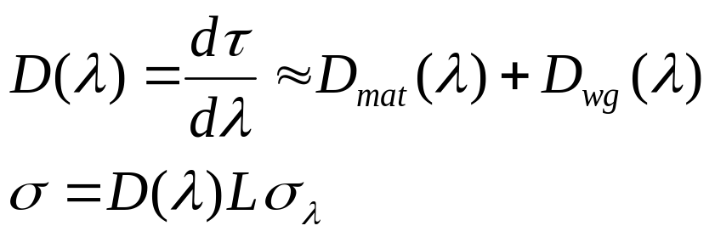
Single mode Cut-off wavelength & Dispersion
Fundamental mode is with V=2.405 and
Dispersion:
For non-dispersion-shifted fibers (1270 nm – 1340 nm)
For dispersion shifted fibers (1500 nm- 1600 nm)
[3-30]
[3-31]
[3-32]

Slide 37
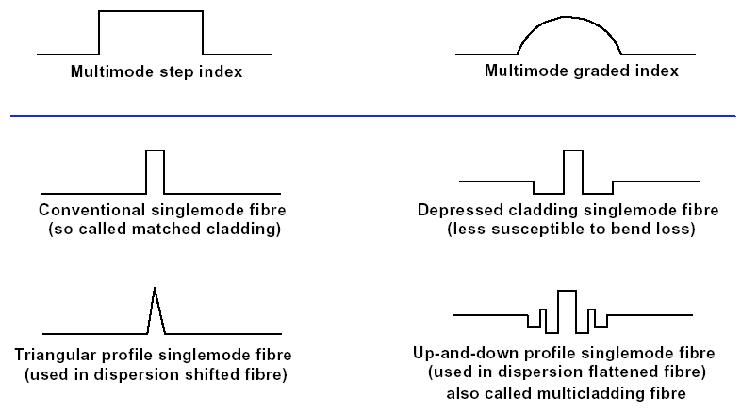
Refractive Index Profile of Fibers

Slide 38
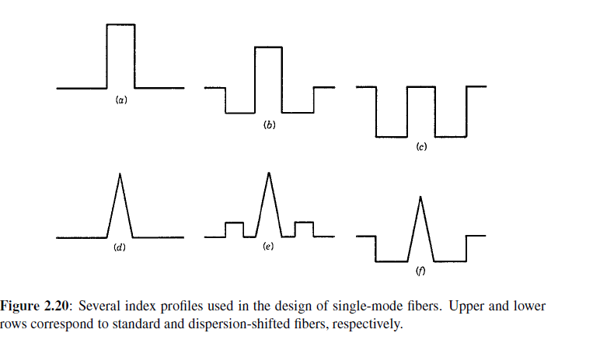

Slide 39
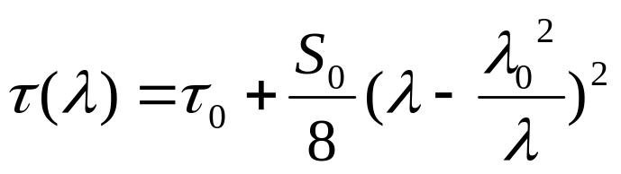




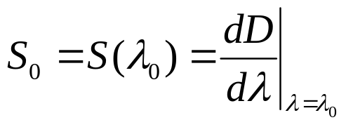
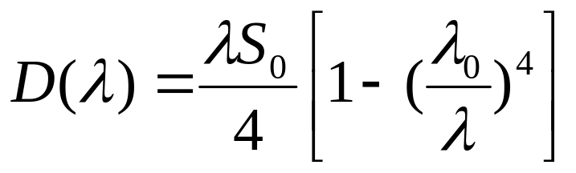
Dispersion for non-dispersion-shifted fibers
(1270 nm – 1340 nm)
is relative delay minimum at the zero-dispersion wavelength , and is the value of the dispersion slope in .
[3-33]
[3-34]
[3-35]

Slide 40
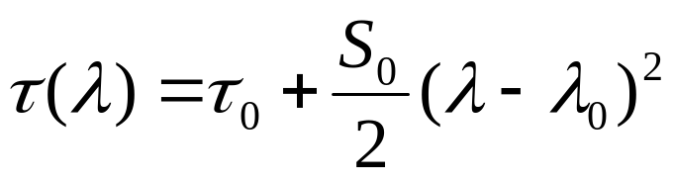
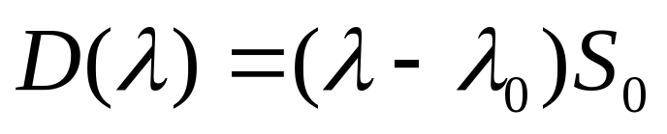
Dispersion for dispersion shifted fibers (1500 nm- 1600 nm)
[3-36]
[3-37]

Slide 41
WDM System Function
Wavelength
Converter
Wavelength
Converter
1
1
Wavelength
Converter
Wavelength
Converter
2
2
Mux &
Demux
Mux &
Demux
Wavelength
Converter
Wavelength
Converter
n
n
Ch 1
Ch 2
Ch n

Slide 42
Design Parameters of WDM Network
Number of Wavelengths
Bit Rate per Wavelength
Channel Spacing
Useable Bandwidth
Bandwidth Efficiency
Span between Optical Amplifiers
Transmission Span without Regeneration

Slide 43
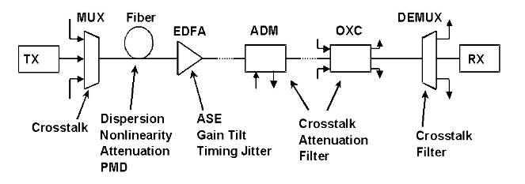
Sources of WDM Network Degradation

Slide 44


Slide 45
Problem Posed by Chromatic Dispersion
Chromatic Dispersion
  Non-zero β₂ at 1550nm (D=17ps/nm-km)
  Different frequencies travel at different group velocities
  Results in pulse broadening causing ISI
  Sources of chromatic dispersion
    Finite Laser line-width
    Laser Chirp due to direct modulation
    Finite Bandwidth of the bit sequence

Slide 46

Chromatic Dispersion (CD)
Effect and consequences
The refractive index has a wavelength dependent factor, so the different frequency-components of the optical pulses are travelling at different speeds (the higher frequencies travel faster than the lower frequencies)
The resulting effect is a broadening of the optical pulses and a consequent interference between these broadened pulses
Counteractions
CD compensation, Use of DS or NZDS fibres, combinations of these two techniques

Slide 47
SMF, DSF, NZDSF
SMF : Single Mode Fiber
covered by ITU-T G.652 Recommendation
DSF : Dispersion Shifted Fiber
covered by ITU-T G.653 Recommendation
NZDSF : Non-Zero Dispersion Shifted Fiber
covered by ITU-T G.655 Recommendation

Slide 48
Chromatic Dispersion (CD)
The dispersion paradigm :
  Even if it is important to reduce Chromatic Dispersion in order to achieve longer transmission distances
  ... HOWEVER ...
  too little dispersion means too high non-linear effects in the transmission fiber that can severely degrades Bit Error Ratio (BER)

Slide 49
Fiber Nonlinearities
As long as optical power within an optical fiber is small, the fiber can be treated as a linear medium; that is the loss and refractive index are independent of the signal power
When optical power level gets fairly high, the fiber becomes a nonlinear medium; that is the loss and refractive index depend on the optical power

Slide 50
Limitations :
short list of fibre nonlinearities
Single-channel
Multi-Channel/WDM
Kerr effect
n = n(ω) + n₂
P(t)
A_{eff}
Self-phase modulation (SPM)
signal optical phase modulated
proportionally to signal power;
conversion to intensity «noise» by GVD.
Cross-phase modulation (XPM)
Signal optical phase modulated
proportionally to power of neighboring
channels; conversion to intensity «noise»
by GVD.
Modulation instability (MI)
(anomalous dispersion regime only)
selective amplification of noise.
Four-wave mixing (FWM)
Generation of new spectral components;
crosstalk when overlap with other channels.
Other interactions with medium
Stimulated Brillouin scattering (SBS)
Retrodiffusion of energy;
increases fibre loss.
Stimulated Raman scattering (SRS)
Energy transfer from lower-wavelength
channels to higher-wavelength ones.

Slide 51

Effects of Nonlinearites

Slide 52
Stimulated Raman Scattering (SRS)
1) Effect and consequences
SRS causes a signal wavelength to behave as a “pump” for longer wavelengths, either other signal channels or spontaneously scattered Raman-shifted light. The shorter wavelengths is attenuated by this process, which amplifies longer wavelengths
SRS takes place in the transmission fiber
2) SRS could be exploited as an advantage
By using suitable Raman Pumps it is possible to implement a Distributed Raman Amplifier into the transmission fiber. This helps the amplification of the signal (in co-operation with the localized EDFA). The pumps are depleted and the power is transferred to the signal
Transmission Fiber
f
f

Slide 53
Non Linear Effects:
Cross Phase Modulation (XPM)
XPM acts as a crosstalk penalty, which increases with increasing channel power level and system length and with decreasing channel spacing
XPM causes a spectral broadening of the optical pulses and thus reduces the dispersion tolerance of the system
At 10 Gbps, its penalty is minimized by distributing dispersion compensation at each line amplifier site
If dispersion is compensated only at the terminal ends, there will be a residual penalty due to XPM

Slide 54

FIBER EFFECTIVE LENGTH
Nonlinear interaction depends on transmission length and cross-sectional area of the fiber
The longer the length, the more the interaction and the worse the effect of the nonlinearity.
BUT, signal propagates along link and experiences loss (from fiber attenuation) …
  ...complicated to model.
Simple model: Assume power is constant over a certain effective length
P denotes power transmitted into fiber. L denotes actual fiber length
P(z) = P e-αz power at distance z along link.
Typical:
α = 0.22 dB/km at 1.55um
if L>>1/ α ,then L_{e} approx 20 km

Slide 55


EFFECTIVE CROSS SECTIONAL AREA
Effect of nonlinearity grows with intensity in the fiber. This is inversely proportional to the area of the core (for a given power).
Power not evenly distributed in the cross section.
Use effective cross sectional area (for convenience).
A = actual cross sectional area
I(r, θ) = actual cross sectional distribution of the intensity.
Most cases of interest:

Slide 56

SBS
The phonons are acoustic phonons.
Pump and Stokes wave propagate in opposite directions.
Does not typically cause interaction between different wavelengths.
Creates distortion in a single channel.
Depletes the transmitted signal.
The opposite traveling Stokes wave means the transmitter needs an isolator
Meaning: If we launched 1.05mW = 0.2dBm, fiber loss alone would cause the receiver
to receive 0.2dBm-(0.2dB/km)(20km) = -3.8dBm. However, if SBS is present, the Stokes
and signal powers are equal in threshold condition; therefore the receiver gets
-3.8dBm- 3dB = -6.8 dBm. The backwards Stokes wave has power of -6.8 dBm.

Slide 57

SRS
If two or more signals at different wavelengths are injected into a fiber, SRS causes
power to be transferred from the lower wavelength channels to the higher-wavelength
channels.
Has a broadband effect (unlike SBS)
Gain coefficient g_{R} much less than SBS gain coefficient g_{B.}
Both forward and reverse traveling Stokes wave.
Coupling between channels occurs only if both channels sending a “1”. SRS penalty
is therefore reduced by dispersion.
SRS generally does not contribute to fiber systems.

Slide 58
Non Linear Effects:
Four Wave Mixing (FWM)
1) Effect and consequences
FWM is the generation of new optical waves (at frequencies which are the mixing products of the originator signals). This is due to interaction of the transmitted optical waves. The created mixing products interfere with the signal channels causing consequent eye closing and BER degradation Decreasing channel spacing and chromatic dispersion will increase FWM
N channels → N²(N-1)/2 side bands are created, causing
  Reduction of signals
  Interference
  Cross talk
2) Counteractions
Avoid use of ITU-T G.653 (DSF) fiber, Use of ITU-T G.652 (SMF) fiber and ITU-T G.655 (NZDSF) fiber
Unequal channel spacing will cause the mixing products to be created at different frequencies which do not interfere with the signal channels

Slide 59

Non Linear Effects:
Four Wave Mixing (FWM) cont…
Consider a simple three wavelength (λ1, λ2 & λ3)
Let’s assume that the input wavelengths are λl = 1551.72 nm, λ2 = 1552.52 nm & λ3 = 1553.32 nm. The interfering wavelengths that are of most concern in our hypothetical three wavelength system are:
  λ1 + λ2 - λ3 = 1550.92 nm
  λ1 - λ2 + λ3 = 1552.52 nm
  λ2 + λ3 . λ1 = 1554.12 nm
  2λ1 - λ2 = 1550.92 nm
  2λ1 - λ3 = 1550.12 nm
  2λ2 - λ1 = 1553.32 nm
  2λ2 - λ3 = 1551.72 nm
  2λ3 - λ1 = 1554.92 nm
  2λ3 - λ2 = 1554.12 nm

Slide 60
Critical Issues
Receiver Sensitivity (Minimum Power @ RX)
Fiber Chromatic Dispersion
Fiber PMD
Non-linear Effects
Mode partition Noise

Slide 61
Mode partition Noise
Mode Partition Noise is a problem in single mode fiber operation
The problem is that fiber dispersion varies with wavelength.
With changes in the wavelength of the laser, the group velocity also changes.
Thus instead of getting an even dispersion as we might if all wavelengths were produced simultaneously, we get random and unpredictable variations in the received signal strength – even during a single bit time
This is a form of noise and degrades the quality of the received signal

Slide 62
Polarization-Mode Dispersion
Singlemode actually has two orthogonal components
Real fiber is not completely symmetric
  Recall geometry data in sheets
Components propagate at different velocities
Thus, another form of dispersion (PMD)
Small, but significant when other forms of dispersion are suppressed

Slide 63

Polarizations of fundamental mode
Two polarization states exist in the fundamental mode in a single mode fiber

Slide 64

Polarization Mode Dispersion (PMD)
Each polarization state has a different velocity → PMD
Notes:
8

Slide 65

PMD Pulse Spreading
D_{PMD} does not depend on wavelength
Typical value: 0.5 ps√km
Therefore, 5 ps for a 100 km fiber

Slide 66



Bit Rate of Singlemode Fiber
Recall the bit rate formula
For chromatic dispersion
For polarization-mode dispersion

Slide 67
Dispersion compensation techniques
Postcompensation
Precompensation
Hybrid/Symmetrical Compensation
Optical Equalization Filters
Optical Phase Conjugation
Fiber Bragg gratings
Dispersion Compensation Fibers

Slide 68
Tools to combat Impairments
Power per Channel
Dispersion Compensation
Channel Spacing
Wavelength or Frequency Choice

